Slide 1
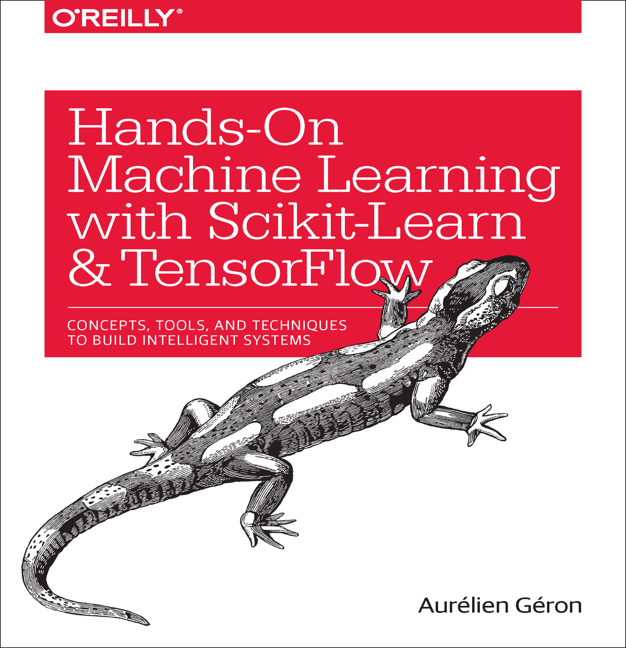
ML seminar 교재 및 계획
Machine Learning with Scikit-Learn
Chapter 1: The Machine Learning Landscape (1/4)
Chapter 2: End-to-End Machine Learning Project (1/9)
Chapter 3: Classification (1/9)
Chapter 4: Training Linear Models (1/11)
Chapter 5: Support Vector Machines (1/16)
Chapter 6: Decision Trees (1/18)
Chapter 7: Ensemble Learning and Random Forests (1/18)
Chapter 8: Dimensionality Reduction (1/23)
Deep Learning with TensorFlow
Chapter 9: Up and Running with TensorFlow (1/25)
Chapter 10: Introduction to Artificial Neural Networks (1/25)
Chapter 11: Training Deep Neural Nets (1/30)
Chapter 12: Distributing TensorFlow Across Devices and Servers (2/1)
Chapter 13: Convolutional Neural Networks (2/6)
Chapter 14: Recurrent Neural Networks (2/6)
Chapter 15: Autoencoders (2/8)
Chapter 16: Reinforcement Learning (2/13)

Slide 2
Chapter 1. The Machine Learning Landscape

Slide 3
What Is Machine Learning?
General definition:
Machine Learning is the field of study that gives computers the ability to learn without being explicitly programmed.
- Arthur Samuel, 1959
Engineering-oriented definition:
A computer program is said to learn from experience E with respect to some task T and some performance measure P, if its performance on T, as measured by P, improves with experience E.
- Tom Mitchell, 1997

Slide 4
What Is Machine Learning?
Engineering-oriented definition:
A computer program is said to learn from experience E with respect to some task T and some performance measure P, if its performance on T, as measured by P, improves with experience E.
Tom Mitchell, 1997
어떤 컴퓨터 프로그램이 어떤 작업(T)을 하는데 있어서 경험(E)에 따라서 측정된 성능(P)이 개선된다면 그 프로그램은 경험(E)에서 학습한다고 할 수 있다.

Slide 5
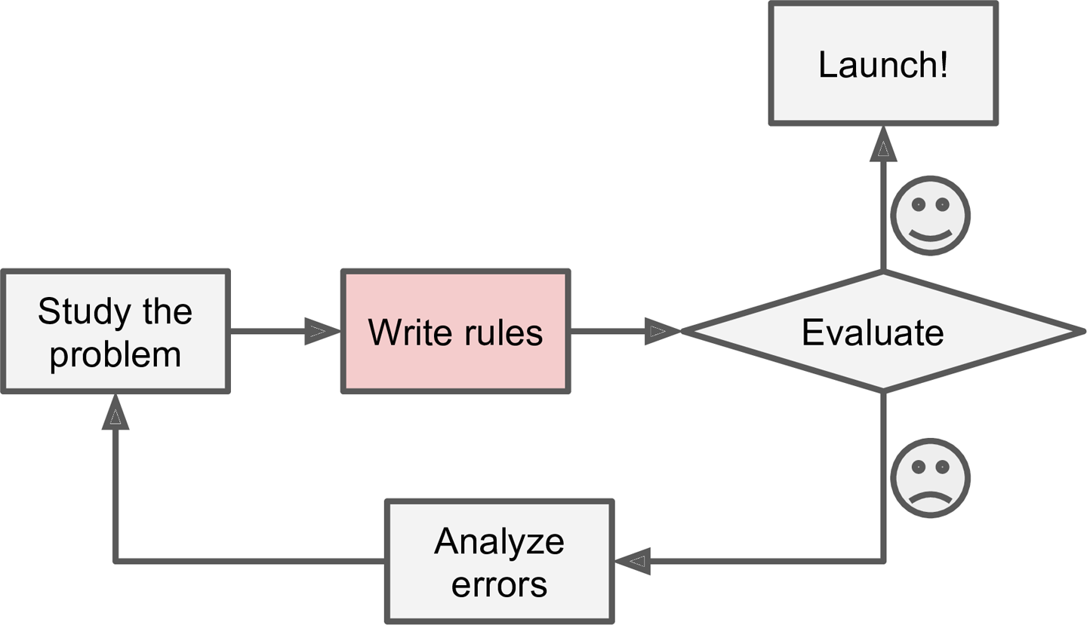
Why Use Machine Learning?
< Spam filter example >
The traditional approach
spam_keywords = ['4U', 'free']
def spam_filter(email):
for word in email:
if word in spam_keywords:
return "SPAM!"
return "HAM!"
email1 = ['Hi','Daeung','Special','gift','4U']
print("email1 is " + spam_filter(email1))
email2 = ['Hi','Daeung','Special','gift','for U']
print("email2 is " + spam_filter(email2))
email1 is SPAM!
email2 is HAM!

Slide 6
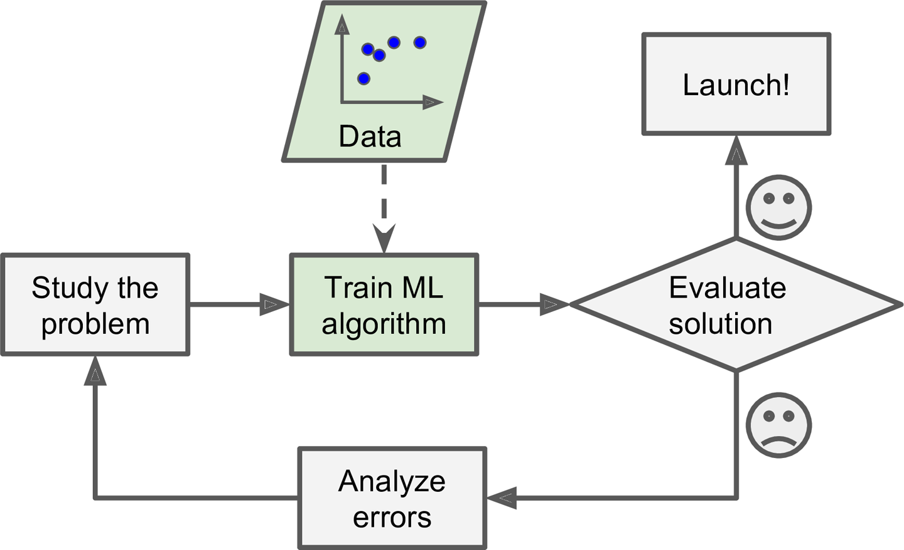
Why Use Machine Learning?
< Spam filter example >
Machine Learning approach
model = MLAlgorithm()
model.fit(emails, email_labels)
email1 = ['Hi','Daeung','Special','gift','4U']
print("email1 is " + model.predict(email1))
email2 = ['Hi','Daeung','Special','gift','for U']
print("email2 is " + model.predict(email2))
email1 is SPAM!
email2 is SPAM!

Slide 7
Why Use Machine Learning?
The traditional approach
Machine Learning approach

Slide 8
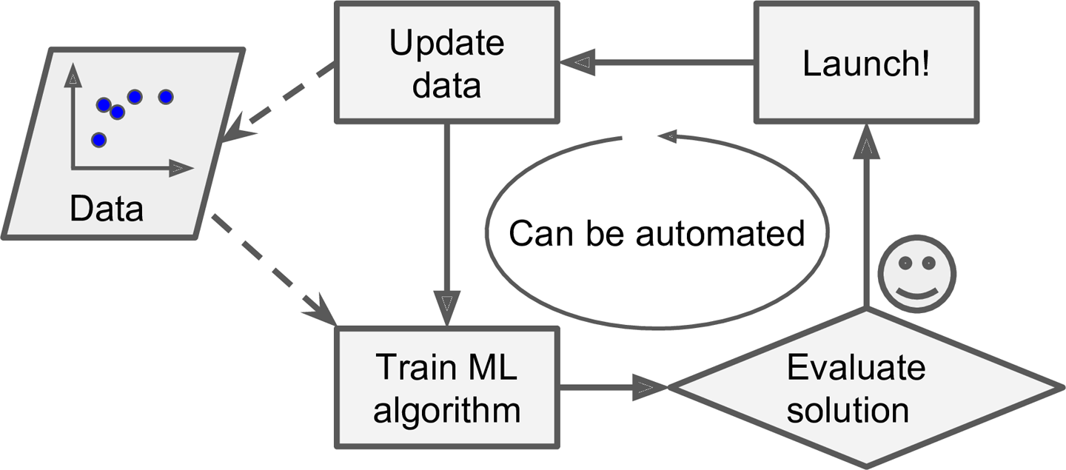
Why Use Machine Learning?
The traditional approach
Machine Learning approach

Slide 9
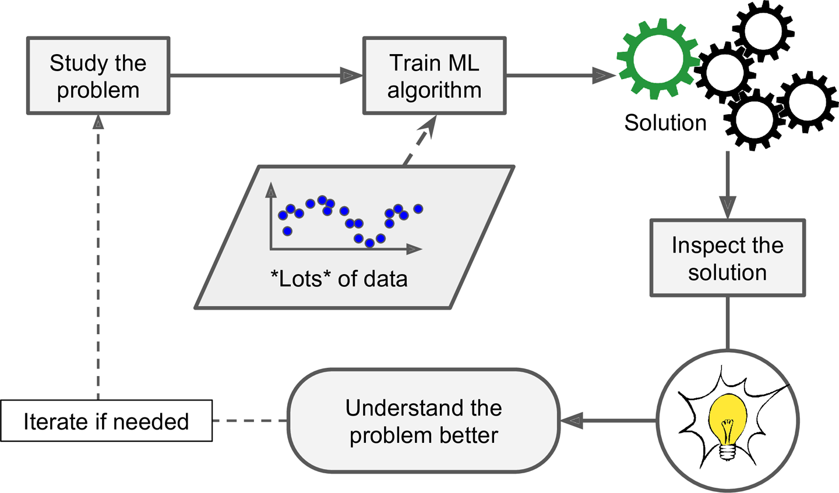
Why Use Machine Learning?
Machine Learning can help humans learn

Slide 10
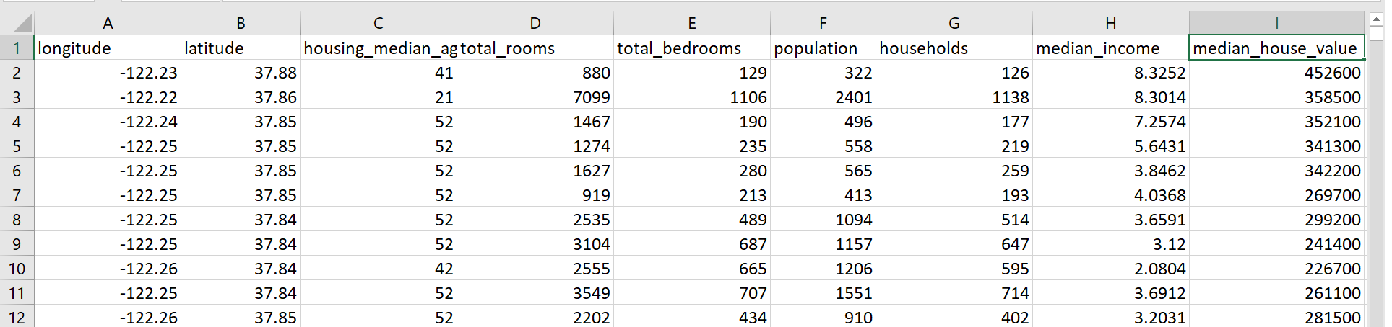
용어 정리
집값 예측 문제

Slide 11
용어 정리
Attribute
Feature = Attribute + its value (longitude = -122.23)
Labels
Instance(sample)

Slide 12
용어 정리
Attribute
Feature = Attribute + its value (longitude = -122.23)
Labels
Instance(sample)
attributes = [‘longitude’, ‘latitude’, …, ‘median_income’]
number of attributes = number of features = dimension of data = 8
number of data (or instances or samples) = 11
size of data = number of data x number of attributes
In python code:
In [1]: print(X_train.shape)
Out[1]: (11, 8)

Slide 13
Types of Machine Learning Systems
Whether or not they are trained with human supervision:
supervised, unsupervised, semisupervised, and Reinforcement Learning
Whether or not they can learn incrementally on the fly
online vs. batch learning
Whether they work by simply comparing new data points to known data points, or instead detect patterns in the training data and build a predictive model, much like scientists do
instance-based vs. model-based learning

Slide 14
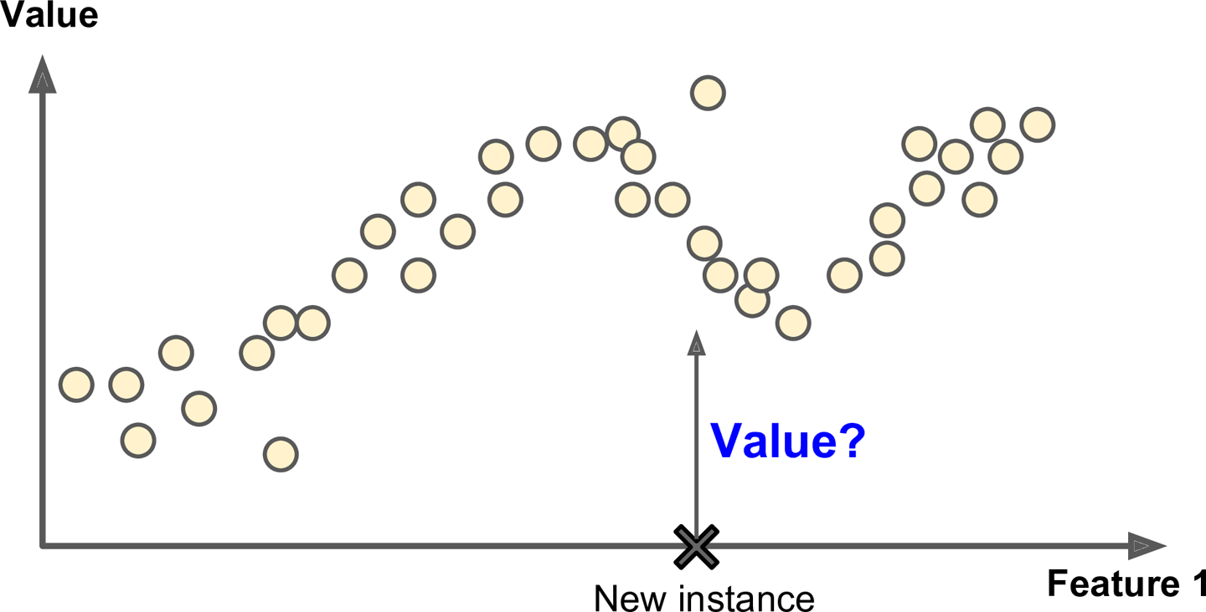
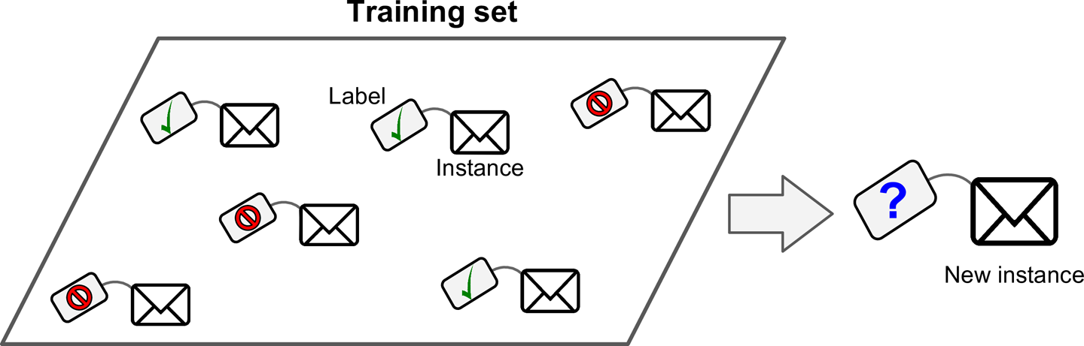
Supervised Learning
Label(미리 정해놓은 정답)이 있는 자료로 학습
Classification
Regression

Slide 15
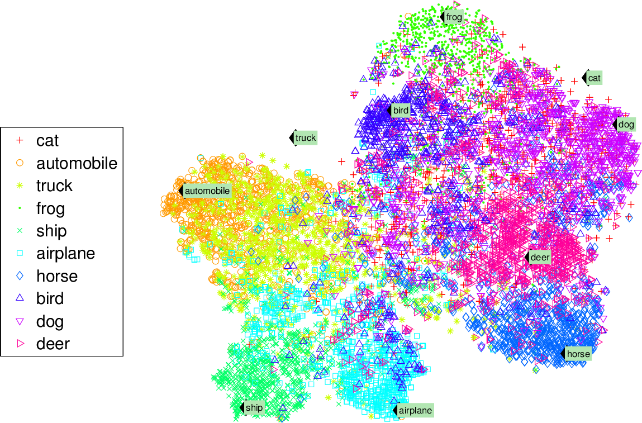
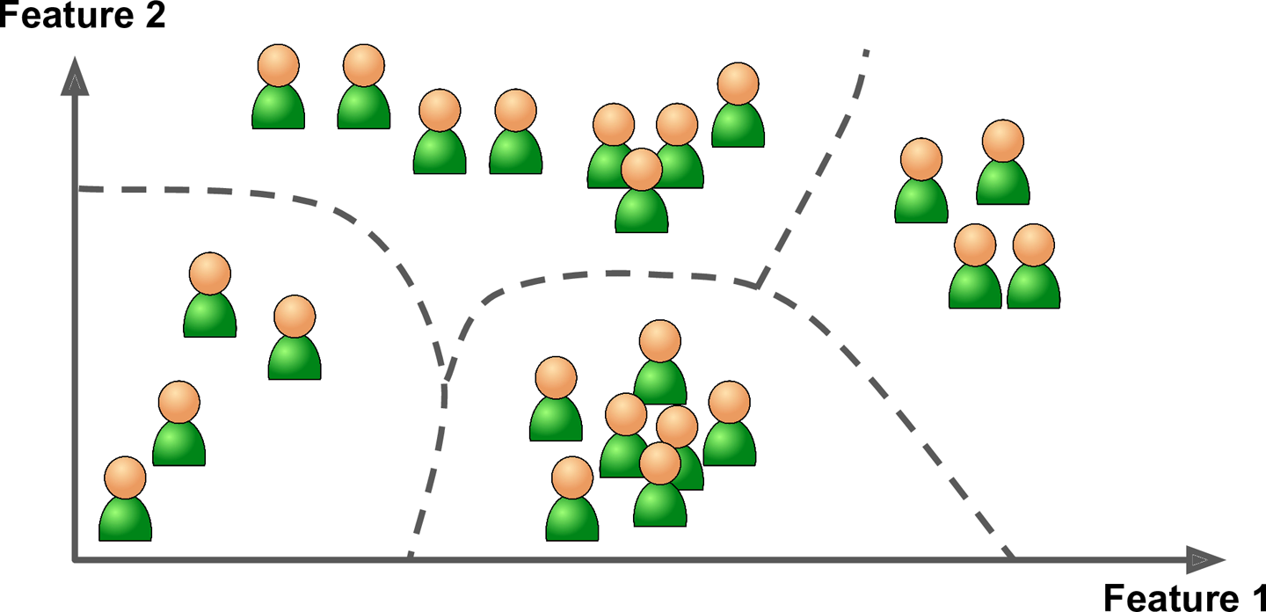
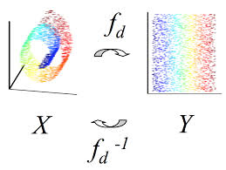
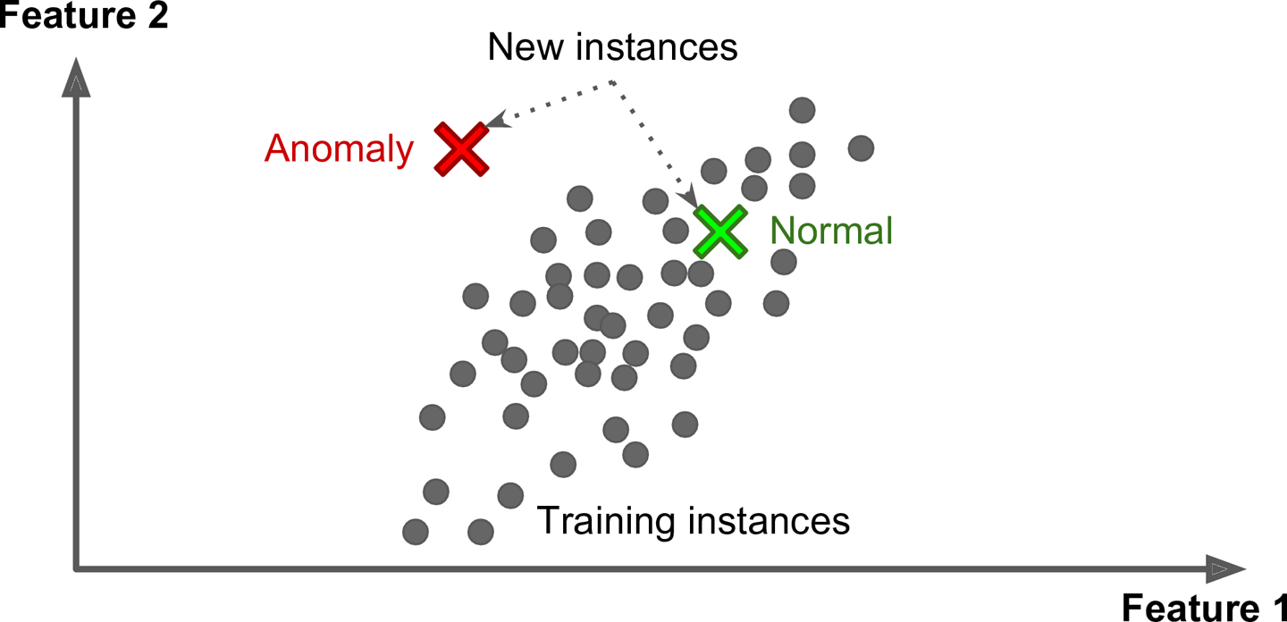
Unsupervised Learning
Label(미리 정해놓은 정답)이 없는 경우
데이터에 내재된 패턴, 특성, 구조를 학습을 통해 발견
Clustering
t-SNE visualization
Dimensionality reduction
Anomaly detection

Slide 16
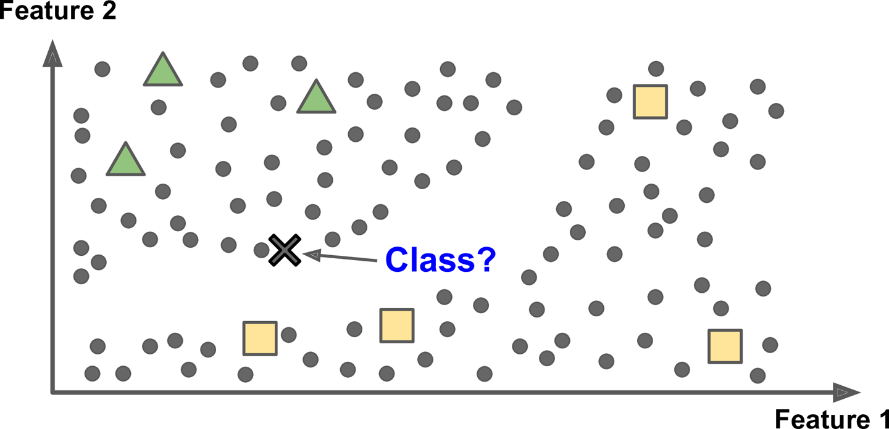
Semisupervised Learning
정답이 있는 데이터가 적고 정답이 없는 데이터가 많은 경우

Slide 17

Reinforcement Learning

Slide 18
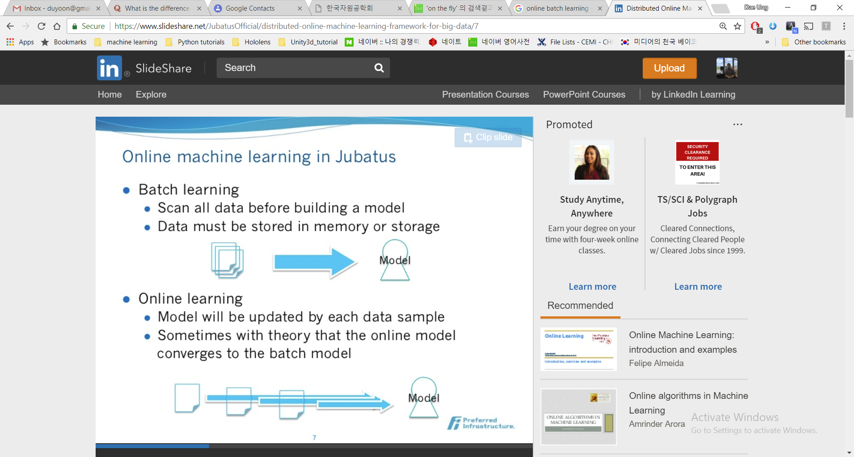
Batch and Online Learning
Batch learning (offline learning)
Scan all data before building a model
Data must be stored in memory or storage
Online learning
Model will be updated by feeding data instances sequentially, either individually or by small groups called mini-batches
Sometimes with theory that the online model converges to the batch model

Slide 19
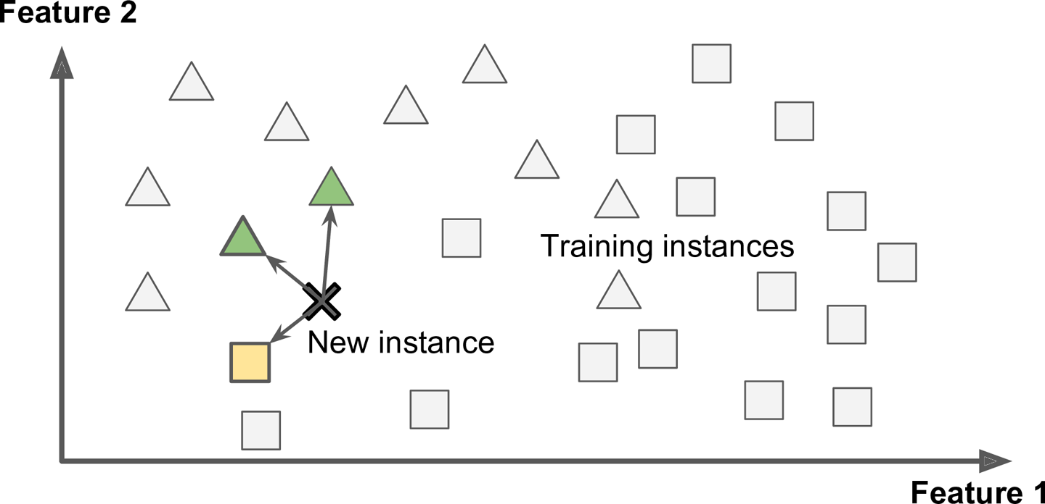
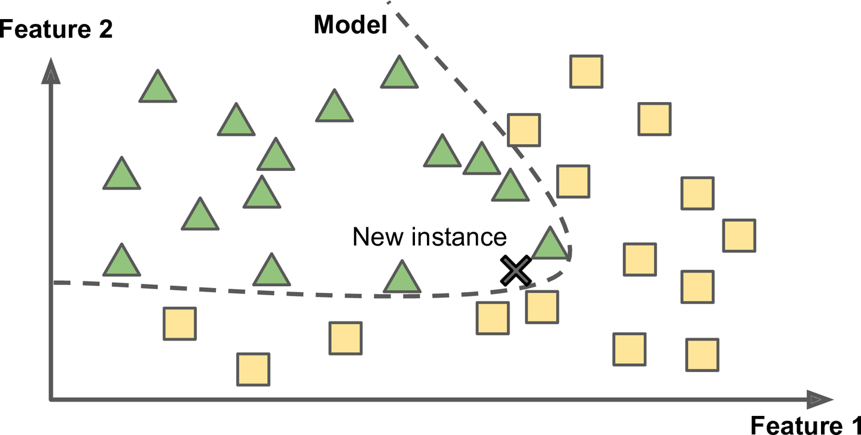
Instance-Based vs. Model-Based Learning
Instance-Based Learning
Model-Based Learning

Slide 20
Types of Machine Learning Systems
Whether or not they are trained with human supervision:
supervised, unsupervised, semisupervised, and Reinforcement Learning
Whether or not they can learn incrementally on the fly
online vs. batch learning
Whether they work by simply comparing new data points to known data points, or instead detect patterns in the training data and build a predictive model, much like scientists do
instance-based vs. model-based learning
예) 비트코인 가격 예측
과거의 비트코인 가격 정보 이용 ➔ supervised learning
가격 예측 ➔ regression
실시간 자료 업데이트 ➔ online learning
linear regression을 이용할 경우 ➔ model-based learning

Slide 21
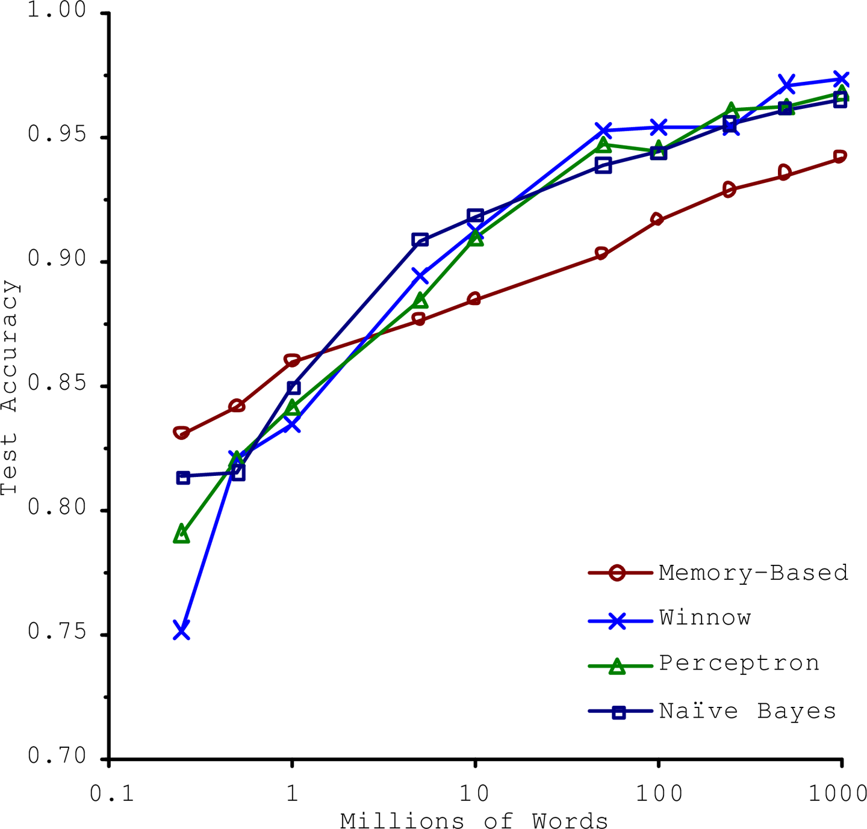
Main Challenges of Machine Learning
Challenge 1: “BAD DATA”
Insufficient Quantity of Training Data
Nonrepresentative Training Data
Poor-Quality Data
Irrelevant Features
[Banko and Brill, 2001]

Slide 22
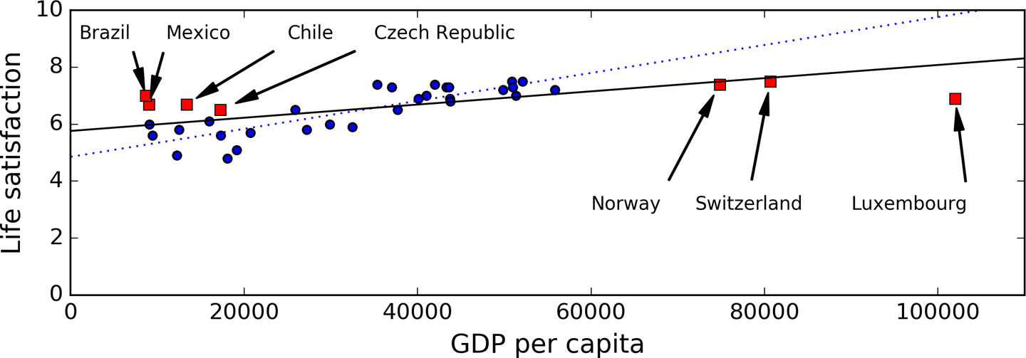
Main Challenges of Machine Learning
Challenge 1: “BAD DATA”
Insufficient Quantity of Training Data
Nonrepresentative Training Data
Poor-Quality Data
Irrelevant Features

Slide 23
Main Challenges of Machine Learning
Challenge 1: “BAD DATA”
Insufficient Quantity of Training Data
Nonrepresentative Training Data
Poor-Quality Data
clear outliers
handle missing values
Irrelevant Features

Slide 24
Main Challenges of Machine Learning
Challenge 1: “BAD DATA”
Insufficient Quantity of Training Data
Nonrepresentative Training Data
Poor-Quality Data
Irrelevant Features
select the most useful features
combine existing features to produce a more useful one
create new features by gathering new data
→ Feature engineering

Slide 25
Main Challenges of Machine Learning
Challenge 2: “BAD ALGORITHMS”
Training Data:
x₂
x₂
x₂
x₁
x₁
x₁
Under-fitting
Appropriate-fitting
Over-fitting

Slide 26
Main Challenges of Machine Learning
Challenge 2: “BAD ALGORITHMS”
Training Data:
Validation Data:
x₂
x₂
x₂
x₁
x₁
x₁
Under-fitting
Appropriate-fitting
Over-fitting

Slide 27
Main Challenges of Machine Learning
Challenge 2: “BAD ALGORITHMS”
The possible solutions for overfitting are:
To gather more training data
To reduce the noise in the training data (e.g., fix data errors and remove outliers)
To simplify the model
by selecting one with fewer parameters,
by reducing the number of attributes in the training data, or
by constraining the model (regularization)

Slide 28
How To Evaluate Model Performance?
Single Validation
Training
data
Training
set
Predict
Label
Machine Learning Algorithm
Train
Accuracy
Validation
Accuracy
Validation
Predict
Label

Slide 29
How To Evaluate Model Performance?
k-fold Cross Validation
k = 5
Training
data
Training
set
Training
set
Training
set
Validation
Validation
Training
set
Validation
Training
set
Validation
Validation

